Slide 1
GROWISE: AI POWERED DYNAMIC LEARNING PLATFORM
Umair Imran – 22L8370
Muhammad Shahzad – 22L7530
Ameer Tufail – 22L7555
Supervisor: Maryam Nasim

Slide 2
TABLE OF CONTENTS
01
02
03
04
05
Problem Statement
Proposed Solution
Prototype Demonstration
Explanation of code
Future Work

Slide 3
TABLE OF CONTENTS
02
03
01
05
06
04
Proposed Solution
System Implementation
Conclusion
Challenges & Future Dev
Problem Statement
Analysis & Evals

Slide 4
THE PROBLEM
70% learners quit online courses

Slide 5
THE PROBLEM
70% learners quit online courses
Wasting time on known courses

Slide 6
THE PROBLEM
Memorizing syntax, not thinking
70% learners quit online courses
Wasting time on known courses

Slide 7
THE PROBLEM
70% learners quit online courses
Zero Real-World Preparation
Wasting time on known courses
Memorizing syntax, not thinking

Slide 8
THE PROBLEM
Majority learners quit online courses
Wasting time on known courses
Memorizing syntax, not thinking
Zero Real-World Preparation

Slide 9
TABLE OF CONTENTS
01
02
03
04
05
Problem Statement
Proposed Solution
Prototype Demonstration
Conclusion
Future Work

Slide 10
TABLE OF CONTENTS
01
02
03
04
05
06
Intro & Problem Statement
Proposed Solution
System Implementation
Analysis & Evals
Conclusion
Challenges & Future Dev

Slide 11
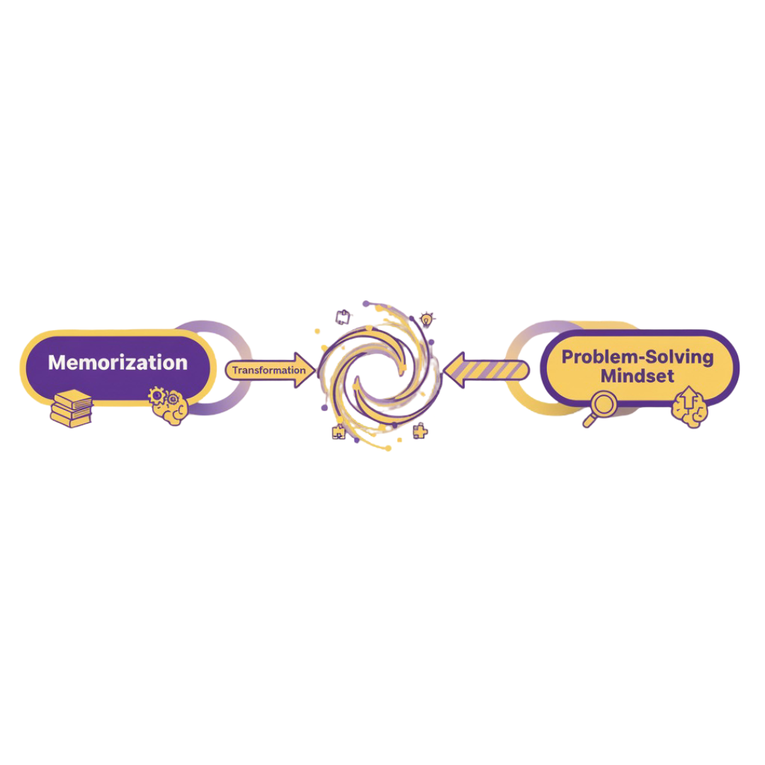
OUR VISION
Real engineering challenges
Teaching How to Think
Problem Solving over memorization
AI mentor always available
Personalized to individual needs

Slide 12
OUR VISION
Teaching How to Think
Problem Solving over memorization
Real engineering challenges
Personalized to individual needs
AI mentor always available

Slide 13
OUR VISION
Teaching How to Think
Problem Solving over memorization
Real engineering challenges
Personalized to individual needs
AI mentor always available

Slide 14
OUR VISION
Teaching How to Think
Problem Solving over memorization
Personalized to individual needs
AI mentor always available
Real engineering challenges

Slide 15
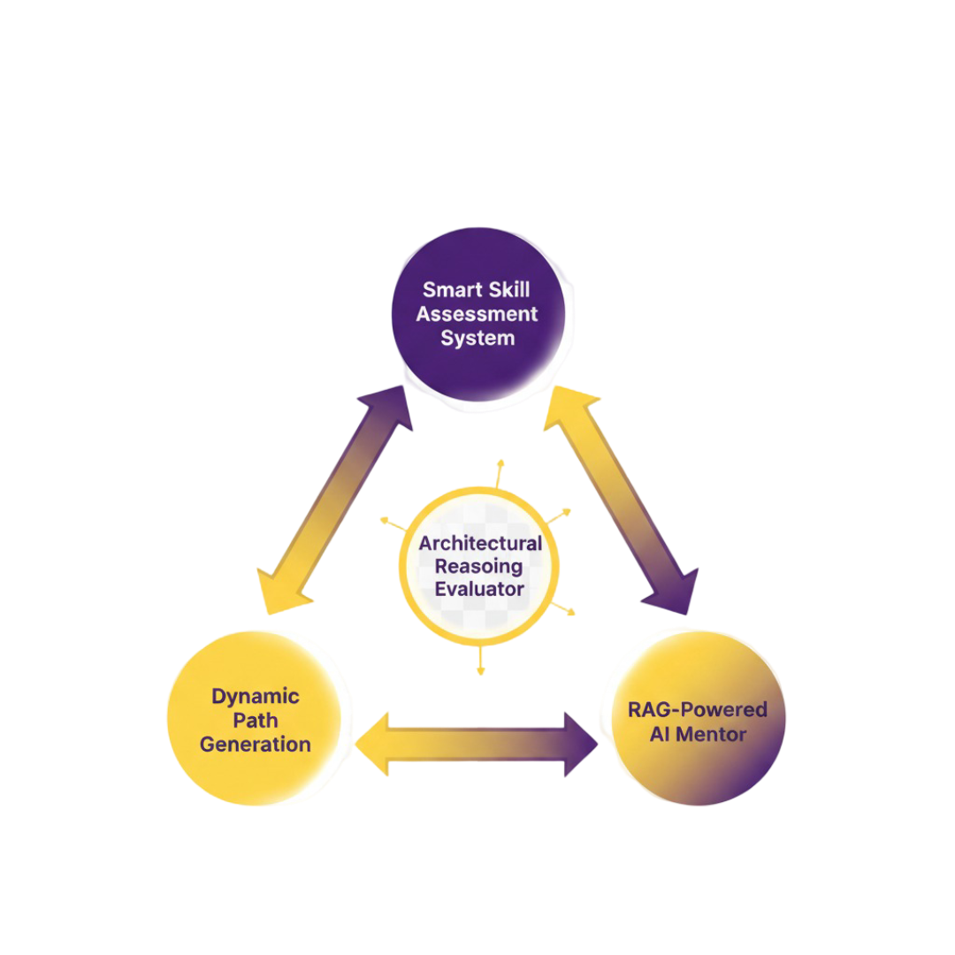
THREE PILLAR AI ARCHITECTURE
Smart Skill Assessment system
Dynamic Path Generation
RAG-Powered AI mentor
Architectural Reasoning Evaluator

Slide 16
THREE PILLAR AI ARCHITECTURE
Smart Skill Assessment system
Dynamic Path Generation
RAG-Powered AI mentor
Architectural Reasoning Evaluator

Slide 17
THREE PILLAR AI ARCHITECTURE
Smart Skill Assessment system
Dynamic Path Generation
RAG-Powered AI mentor
Architectural Reasoning Evaluator

Slide 18
THREE PILLAR AI ARCHITECTURE
Smart Skill Assessment system
Dynamic Path Generation
RAG-Powered AI mentor
Architectural Reasoning Evaluator

Slide 19
THREE PILLAR AI ARCHITECTURE
Smart Skill Assessment system
Dynamic Path Generation
RAG-Powered AI mentor
Architectural Reasoning Evaluator

Slide 20
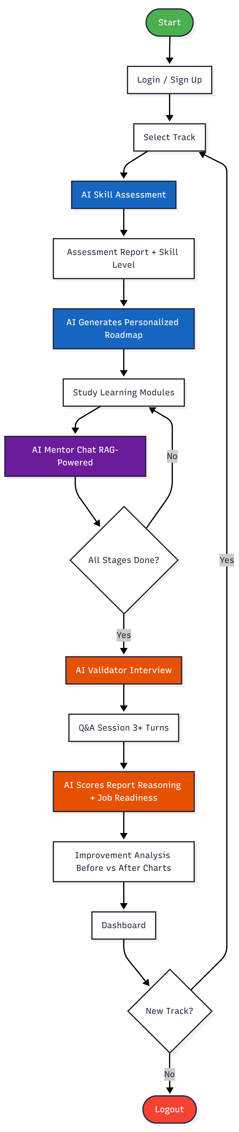

Slide 21
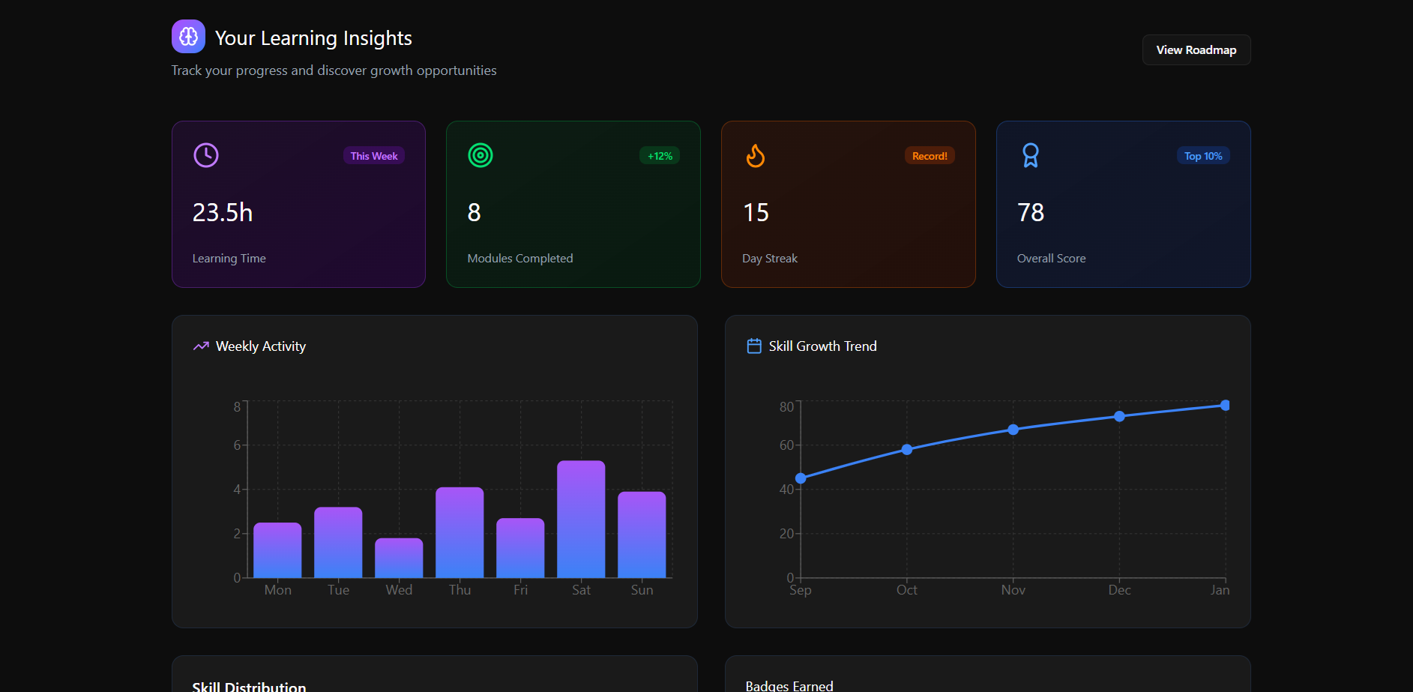

TABLE OF CONTENTS
04
03
01
02
04
05
System Implementation
Demonstration
Problem Statement & Project Scope
Proposed Solution
Analysis & Evals
Literature Review

Slide 22
TABLE OF CONTENTS
05
03
01
02
04
05
Explanation Of code
System Implementation
Problem Statement & Project Scope
Proposed Solution
Analysis & Evals
Literature Review

Slide 23
Future Development
Deployment
Admin panel web application

Slide 24
03
01
02
04
05
Conclusion
System Implementation
Problem Statement & Project Scope
Proposed Solution
Analysis & Evals
Literature Review

Slide 25
THANK YOU
If you have questions, please feel free to ask!

